Slide 1



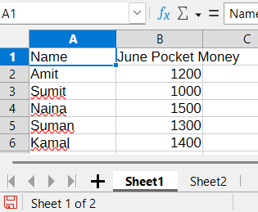
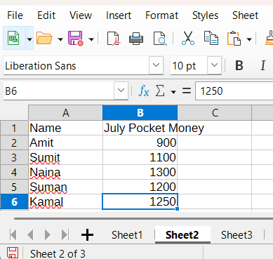
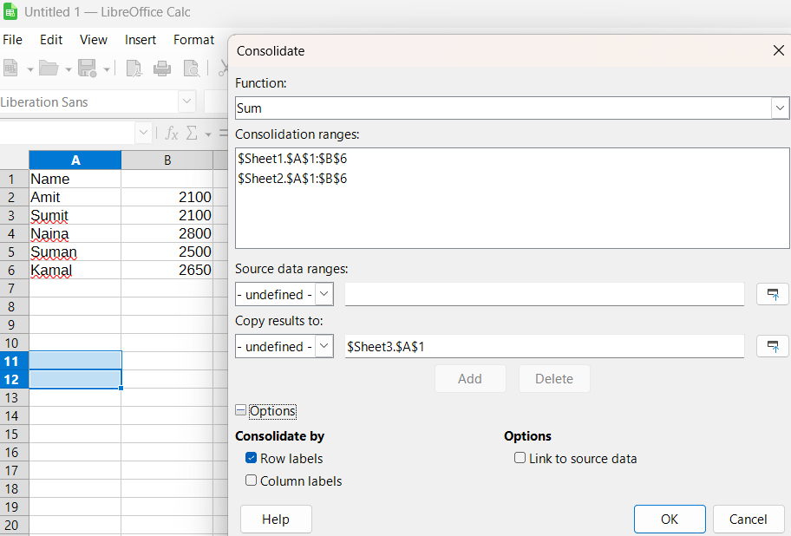
PRACTICAL FILE 1 TO 20 QUESTIONS
NAME: KRISHNA SENGAR
School: Geeta Public School
Class: X (CBSE)
Section: 10th C
Roll Number: 13
Guided By: Sukhwinder Singh Sohal Sir
Q1 Consolidate data of two sheets given below in third sheet of Libre Office Calc.
Procedure
Step 1: Open LibreOffice Calc.
Step 2: In Sheet1, create a table with headings Name and June Pocket Money and enter the data.
Step 3: Insert a new sheet (Sheet2)
and create a table with headings
Name and July Pocket Money,
then enter the data.
Step 4: Insert another new sheet
and rename it as Sheet3 (for
consolidated result).
Step 5: Click on Data → Consolidate.
Step 6: Select Function = Sum.
Add the ranges
Sheet1.$A$1:$B$6 and Sheet2.
$A$1:$B$6.
Step 7: Tick Row labels
under Options and set
Copy results to: Sheet3.
$A$1.
Step 8: Click OK to
consolidate the data.

Slide 2
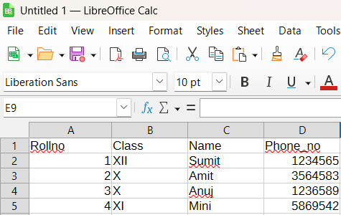
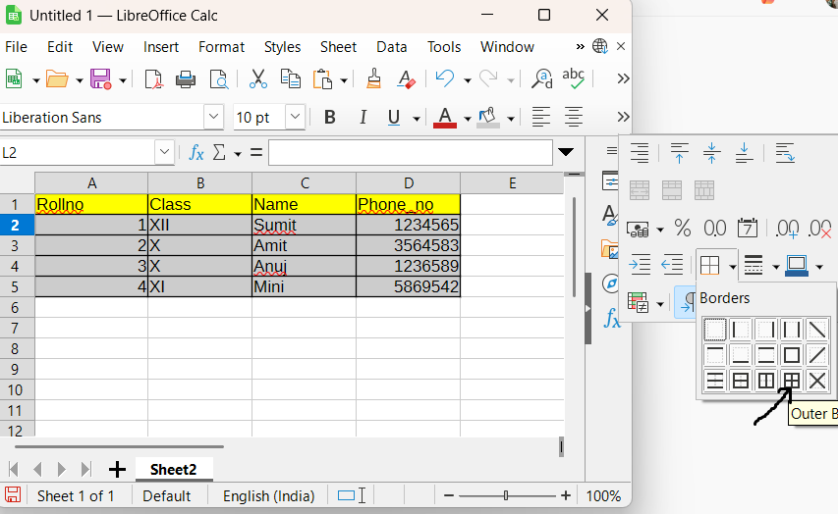
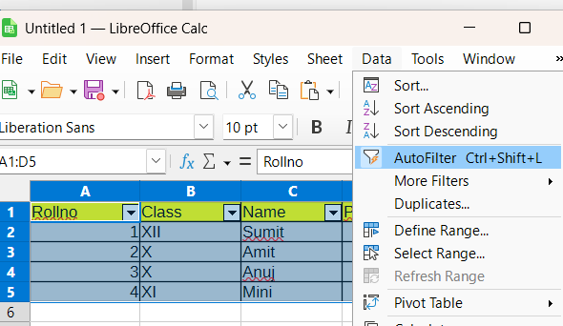
Q2 Consider the Given Table Student mentioning Students details and perform the following:
Procedure
Step 1: Open LibreOffice Calc.
Step 2: In Sheet1, create a table with headings Rollno, Class, Name, Phone_no and enter the required data.
Step 3: Select the header row and apply a background color. Then select the data cells and apply another background color.
Step 4: Select the complete table, click on Borders, and apply Outer Border and All Inner Lines.
Step 5: Select the entire table, go to Data → AutoFilter.

Slide 3
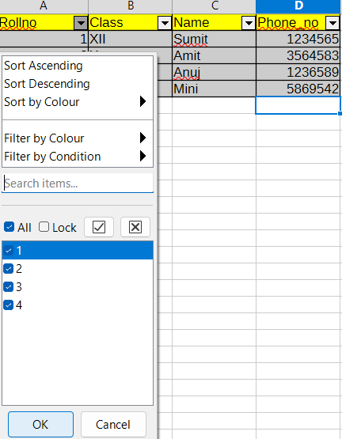
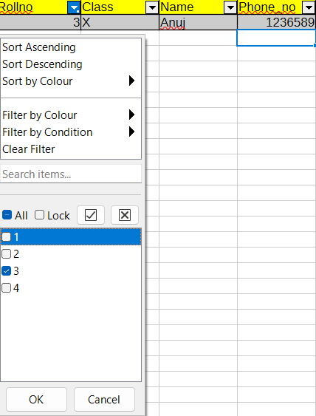
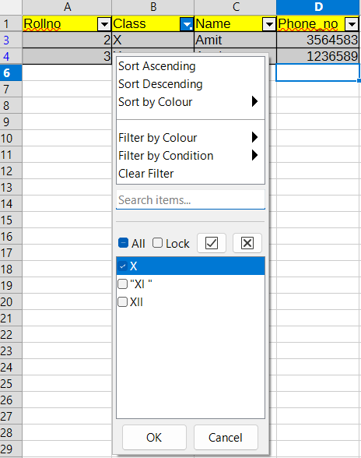
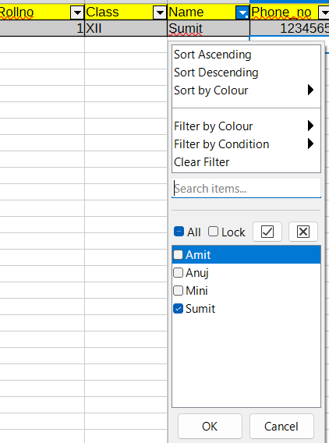
Now Apply Different Filters
Filter 1: Display all records of the table
Click on any filter arrow in the heading row.
Select All.
All records of the table will be displayed.
Filter 2: Display record of student whose
Roll Number is 3
Click on the filter arrow of Rollno column.
Select 3 from the list.
Only the record of the student with roll number 3 will be displayed.
Filter 3: Display records of students who are in Class X
Click on the filter arrow of Class column.
Select X from the list.
Records of students studying in Class X will be displayed.
Filter 4: Display record of student named Sumit
Click on the filter arrow of Name column.
Select Sumit from the list.
The record of Sumit will be displayed.

Slide 4
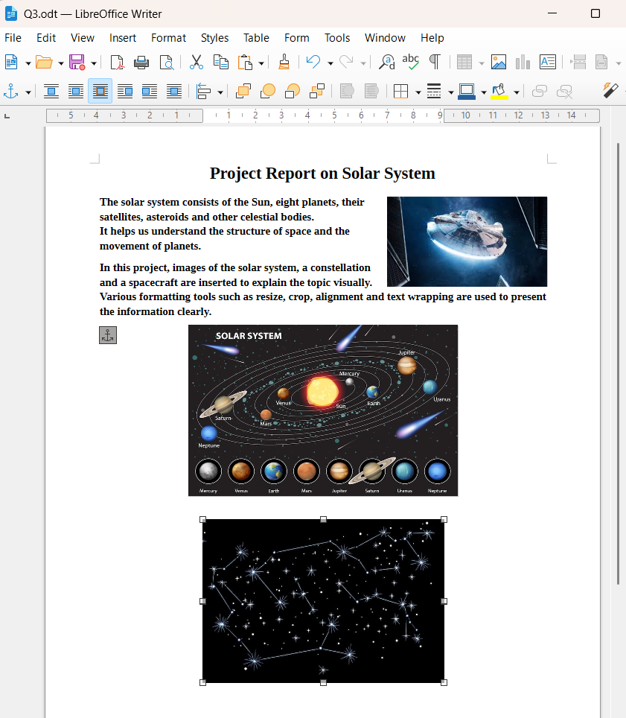
Q3 You are working on a project report about the solar system for your science class.
Insert an image of the solar system, a constellation, and a spacecraft.
Resize the solar system image to fit half of the page width.
Crop the constellation image to remove unnecessary background.
Align the solar system image to the centre of the page.
Place the spacecraft image in the top-right corner of the page with text wrapping around it.

Slide 5

Procedure (Step by Step)
Step 1: Open LibreOffice Writer from the Start Menu.
Step 2: Type the heading Project Report on Solar System, make it Bold and Centre aligned.
Step 3: Type a short report describing the solar system below the heading.
Step 4: Click on Insert → Image, insert the solar system image, resize it to half page width and centre align it.
Step 5: Click on Insert → Image, insert the constellation image, use the Crop tool to remove unnecessary background and resize it.
Step 6: Click on Insert → Image, insert the spacecraft image, place it in the top-right corner and apply text wrapping.
Step 7: Adjust all images properly so that the content fits on one page.
Step 8: Click on File → Save As, give a file name and save the document.
Result
A project report on the solar system is created using images and formatting tools in LibreOffice Writer.
Conclusion
LibreOffice Writer provides easy options to insert, resize, crop, align images and apply text wrapping.

Slide 6
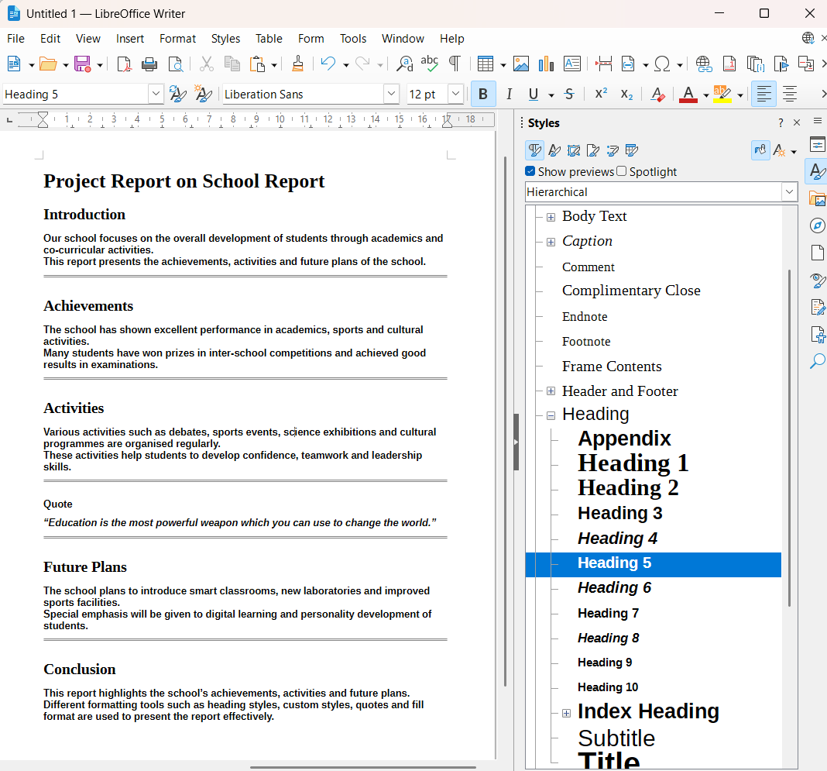
Q4 Mr. Mohit, school teacher, assigned a task to Jatin to create a school report containing sections such as Introduction, Achievements, Activities and Future Plans.
Apply Heading styles for main section titles.
Apply a custom style to quotes within the report.
Use Fill Format to apply a text style to all paragraphs.
Step 1:
LibreOffice Writer open karo aur File → New → Text Document par click karo.
Step 2:
Report ka Title likho “Project Report on School Report” aur use select karke Styles → Title apply karo.
Step 3:
Main sections likho: Introduction, Achievements, Activities, Future Plans, Conclusion.

Slide 7

Step 4:
Har section heading select karke Styles → Heading (Heading 2 / Heading 5) apply karo.
Step 5:
Har heading ke niche paragraph likho aur text select karke Styles → Body Text apply karo.
Step 6:
Quote likho:
“Education is the most powerful weapon which you can use to change the world.”
Step 7:
Quote select karke Bold + Italic apply karo aur Styles → New Style from Selection se Custom Quote Style banao.
Step 8:
Styles panel me Fill Format Mode (paint bucket icon) par click karo aur same style sabhi required paragraphs par apply karo.
Step 9:
Fill Format Mode band karne ke liye Esc key dabao.
Step 10:
Document ko File → Save As se save karo.
Q5 Manish is designing the cover page of your school magazine.
Insert an image of the school building at the centre of the cover page.
Crop and resize the image proportionately.
Add a drop shadow to the image for emphasis.
Q5 – Steps
Step 1: Open LibreOffice Draw.
Step 2: Create a new drawing and type the title of the school magazine at the top of the page.
Step 3: Click on Insert → Image and insert the image of the school building.

Slide 8
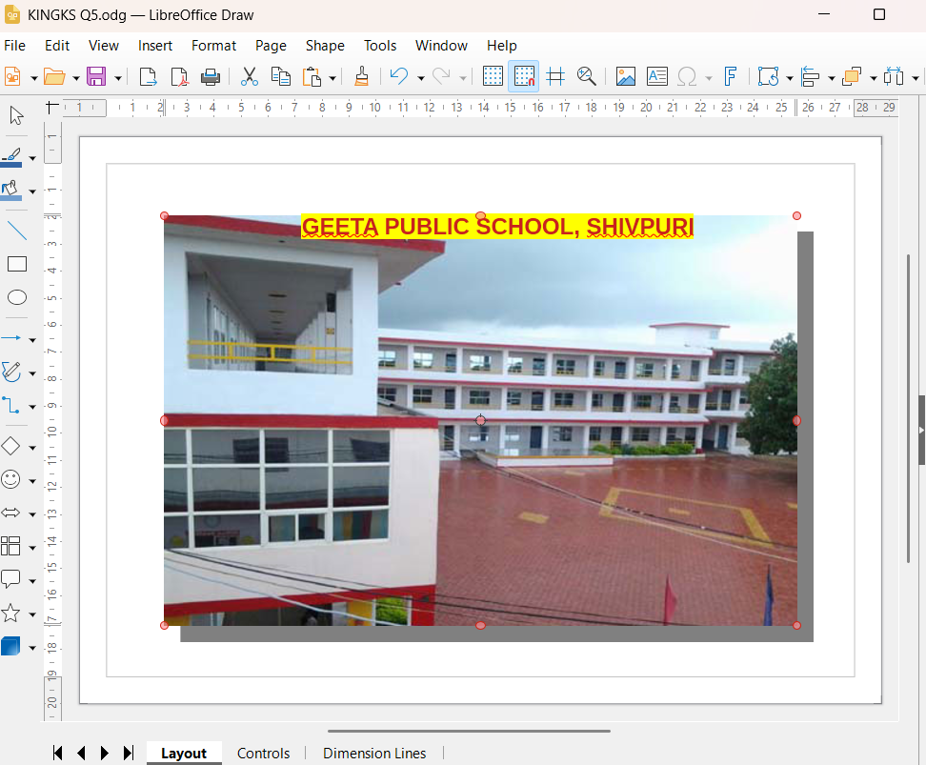
Step 4: Select the image and place it at the centre of the page.
Step 5: Resize the image proportionately using the corner handles.
Step 6: Right-click on the image, select Crop, and remove unnecessary parts.
Step 7: Select the image, open Properties, and enable the Drop Shadow option.
Step 8: Adjust the image position and size to make the cover page attractive.
Step 9: Click on File → Save As and save the drawing.
Result
The cover page of the school magazine is created with a centred image, proportional resizing, cropping and drop shadow effect.

Slide 9
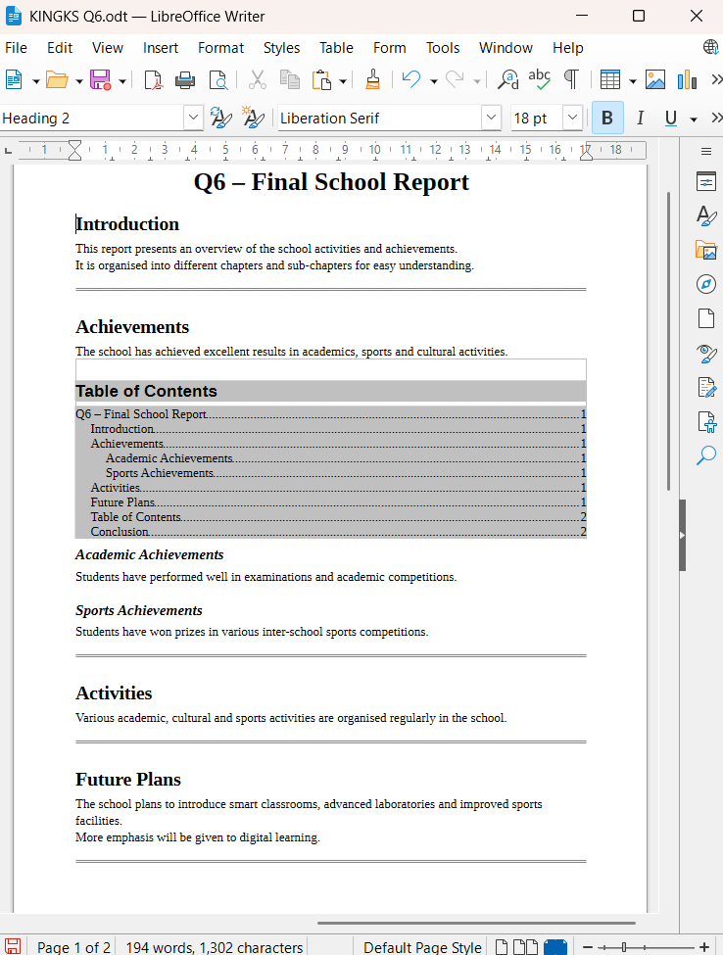
Q6 You are compiling the final report for your school, which includes multiple chapters.
Create a Table of Contents (TOC) that reflects the report with main topics and subtopics.
Apply character styles to the TOC to differentiate between main topics (bold) and subtopics (italic).
Update the TOC as new sections are added to the report.

Slide 10
Q6 – Steps (LibreOffice Writer)
Step 1: Open LibreOffice Writer and open the school report document.
Step 2: Apply Heading styles to the report:
Main title → Heading 1
Main sections → Heading 2
Sub-sections → Heading 3
Step 3: Place the cursor at the position where the Table of Contents (TOC) is required.
Step 4: Click on Insert → Table of Contents and Index → Table of Contents and click OK.
Step 5: Select the main topics in the TOC and apply Bold character style.
Step 6: Select the sub-topics in the TOC and apply Italic character style.
Step 7: Add a new section in the report using the appropriate Heading style.
Step 8: Right-click on the TOC and select Update Index to update the TOC.
Result
The Table of Contents is created and updated with main topics in bold and sub-topics in italic.

Slide 11
Q7 Devash creates a template for the monthly school newsletter.
Design a template with predefined sections for the Principal’s message, events, achievements and student spotlights.
Include a background colour and custom fonts.
Save the template and use it to format the current month’s newsletter.
Step 1: Open LibreOffice Writer and create a new document.
Step 2: Type the title Geeta Public School – Monthly Newsletter and apply Heading 1.
Step 3: Create fixed sections Principal’s Message, Events, Achievements and Student Spotlight and apply Heading 2 to all section headings.
Step 4: Apply a background colour using Format → Page Style → Area.
Step 5: Change the font style and size of the title, headings and text to use custom fonts.
Step 6: Adjust spacing and alignment to make the layout uniform.
Step 7: Save the document as a template using
File → Templates → Save as Template and name it School Newsletter Template.
Step 8: Create a new file using the saved template by clicking
File → New → Templates and selecting the saved template.
Step 9: Enter the current month’s newsletter content in the predefined sections.
Step 10: Save the newsletter file.

Slide 12
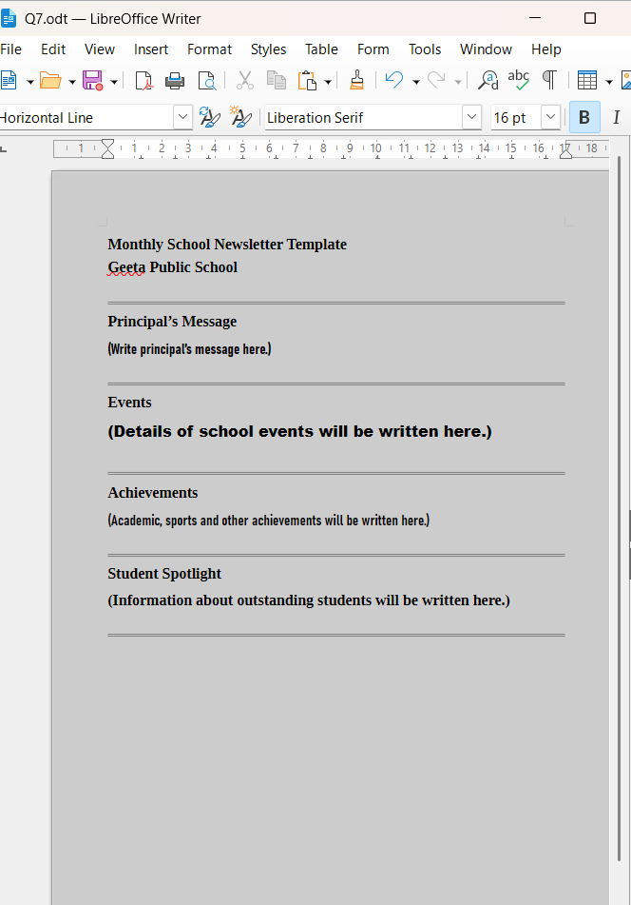

<<<<<< TEMPLATE
Q7
USED TEMPLATE Q7 >>>>>

Slide 13
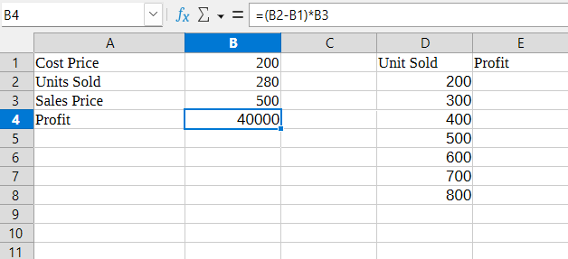
Q8 Create the following sheet and calculate the profit based on different units sold.
Step 1: Open LibreOffice Calc and create a new spreadsheet.
Step 2: Enter the headings as shown below:
A1: Cost Price
A2: Selling Price
A3: Unit Sold
A4: Profit
Step 3: Enter the given values:
B1: 200
B2: 280
B3: 500
Step 4: Click on cell B4 and type the formula to calculate profit:
=(B2-B1)*B3
Press Enter.
(Profit will be displayed, e.g. 40000)
Step 5: Now create the second table for different units sold.
Enter headings:
D1: Unit Sold
E1: Profit

Slide 14
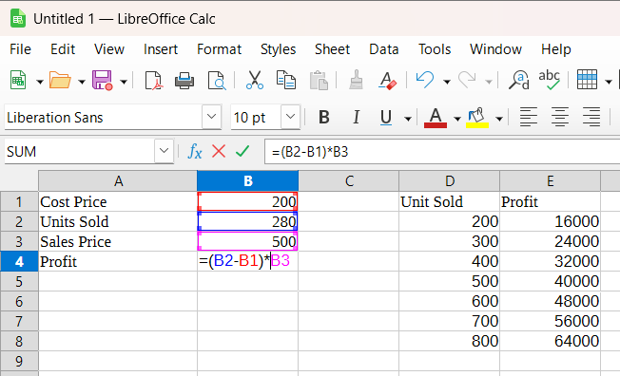
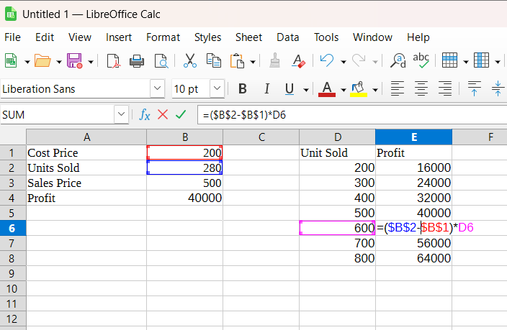
Step 6: Enter unit sold values in column D:
D2 → 200
D3 → 300
D4 → 400
D5 → 500
D6 → 600
D7 → 700
D8 → 800
Step 7: Click on cell E2 and enter the formula:
=(B2-B1)*D2
Press Enter.
Step 8: Use the Fill Handle to copy the formula from E2 to E8 to calculate profit for all units sold.
Step 9: Adjust column width and save the file.
Result
Profit is calculated successfully for different units sold using formulas in LibreOffice Calc.
Conclusion
LibreOffice Calc helps in calculating profit easily by using formulas and fill handle feature.
Profit = (Selling Price − Cost Price) × Units Sold

Slide 15
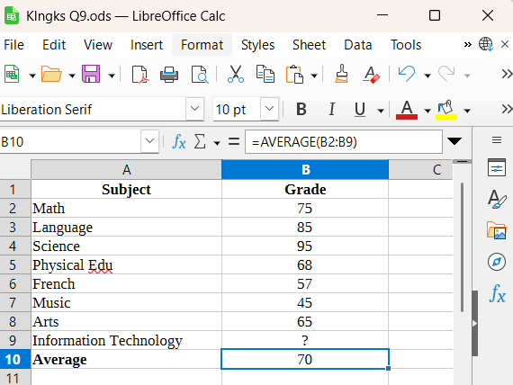
Q9 Consider the following marksheet and use the Goal Seek feature to find the marks in place of question mark (?).
Q9 – Steps (LibreOffice Calc – Goal Seek)
Step 1: Open LibreOffice Calc and create a new spreadsheet.
Step 2: Create the marksheet table by entering Subject in column A and Grade in column B.
Step 3: Enter the given marks for all subjects and leave the cell with question mark (?) blank.
Step 4: In the Average cell, enter the formula to calculate average, for example:
=AVERAGE(B2:B9)
Step 5: Select the cell containing the Average value.
Step 6: Click on Tools → Goal Seek.
Step 7: In the Goal Seek dialog box, fill the following:
Formula cell: Average cell
Target value: 70
Variable cell: Cell containing the missing marks ( ? )
Step 8: Click OK and then click Yes to accept the result.
Step 9: The required marks in place of (?) are displayed automatically.

Slide 16
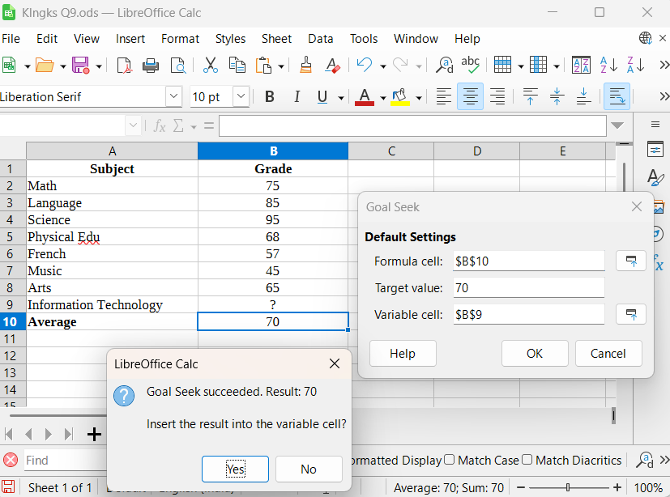
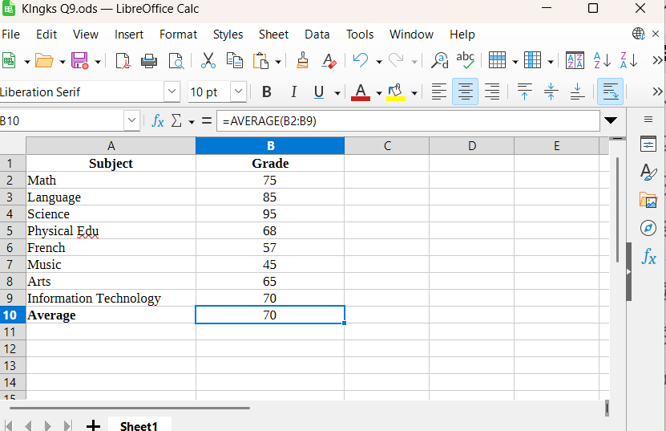
Result
The missing marks are calculated successfully using the Goal Seek feature.
Conclusion
Goal Seek in LibreOffice Calc is used to find an unknown value when the desired result is known.

Slide 17
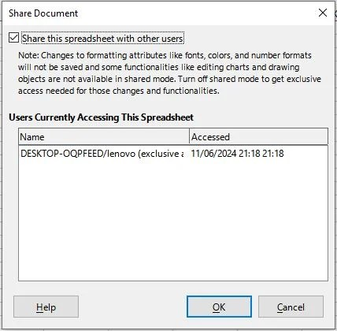
Q10 You and your classmates are working on a group project using a shared spreadsheet.
Perform the following tasks:
Set up a shared spreadsheet for collaboration among classmates.
Practice entering, editing and formatting comments to enhance communication and clarity within the spreadsheet.
Learn to manage changes effectively by reviewing and either accepting or rejecting them.
Step 1: Open LibreOffice Calc and create a new spreadsheet.
Step 2: Save the file so that it can be shared with classmates.
Step 3: Enable sharing by clicking Tools → Share Spreadsheet and click OK.
Step 4: Enter data in the spreadsheet collaboratively with classmates.
Step 5: To add a comment, right-click on a cell and select Insert Comment.

Slide 18
Step 6: Type the comment and format it if required for clarity.
Step 7: Enable change tracking by clicking Edit → TrackChanges → Record.
Step 8: Make changes in the spreadsheet (edit data).
Step 9: Review changes by clicking Edit → Track Changes →Manage.
Step 10: Accept or reject changes as required and save thespreadsheet.
Result
A shared spreadsheet is created where comments are added and changes are tracked, reviewed and managed successfully.
Conclusion
LibreOffice Calc provides tools to collaborate using shared spreadsheets, comments and track changes for effective group work.
In this task, a shared spreadsheet is created using LibreOffice Calc, which is a spreadsheet application based on open-source software. LibreOffice Calc works on a cell-based spreadsheet system, where data is organised in rows and columns. The spreadsheet is shared to allow multiple classmates to collaborate on the same file. Comments are added to cells to improve communication and clarity while working on the project. The Track Changes feature of LibreOffice Calc is used to record all edits made by different users. These changes are reviewed and either accepted or rejected as required. This ensures proper collaboration, transparency, and effective management of group work.

Slide 19
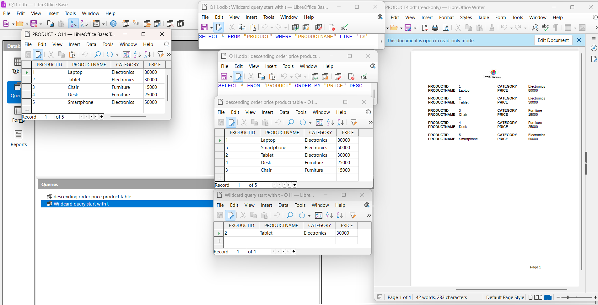
Q11 Consider the following Product table and perform these tasks:
Sort the Product table by Price in descending order.
Use a wildcard to create a query that retrieves all products where the ProductName starts with letter ‘T’.
Generate a report based on the Product table.
Format the report to show products in ascending order of ProductID.
Add the page number in the footer of the report.
Software: LibreOffice Base
Base: Open-source database management system
A. Create Database
Step 1: Open LibreOffice Base.
Step 2: Select Create a new database and click Next.
Step 3: Choose Yes, register the database and click Finish.
Step 4: Save the database with a suitable name (e.g. Q11.odb).

Slide 20
B. Create Table using Design View
Step 5: Click on Tables → Create Table in Design View.
Step 6: Create the following fields:
Field Name | Data Type
PRODUCTID | Integer
PRODUCTNAME | Text (VARCHAR)
CATEGORY | Text (VARCHAR)
PRICE | Integer
Step 7: Set PRODUCTID as the Primary Key.​
Step 8: Save the table as PRODUCT.​
​C. Enter Records
Step 9: Open the PRODUCT table in Data View.
Step 10: Enter the given product records and save the table.
D. Query (Sort by Price – Descending) – Design View
Step 11: Click Queries → Create Query in Design View.
Step 12: Add the PRODUCT table and click Close.
Step 13: Drag all fields to the query grid.
Step 14: In the Sort row of PRICE, select Descending.
Step 15: Click Run Query and save it as
descending order price product table.
E. Query (Wildcard – ProductName starts with T)
Step 16: Create a new query in Design View.
Step 17: Add the PRODUCT table.
Step 18: Drag required fields to the grid.
Step 19: In the Criteria row under PRODUCTNAME, type:
LIKE 'T%'

Slide 21

Step 20: Run and save the query as
Wildcard query start with T.
F. Create Report using Wizard
Step 21: Click Reports → Use Wizard to Create Report.
Step 22: Select PRODUCT table and move all fields to the report.
Step 23: Click Next and select PRODUCTID for sorting in Ascending order.
Step 24: Choose a report layout and click Next.
Step 25: Give a suitable report name and click Finish.
G. Add Page Number in Footer
Step 26: Open the report in Edit Mode.
Step 27: Click Insert → Page Number.
Step 28: Place the page number in the Footer section.
Step 29: Save and close the report.
Result
The PRODUCT table is created, sorted, queried using wildcard, and a report is generated with ProductID in ascending order and page number in the footer.
Conclusion
LibreOffice Base helps in creating tables, queries and reports efficiently using Design View and Wizard tools.

Slide 22
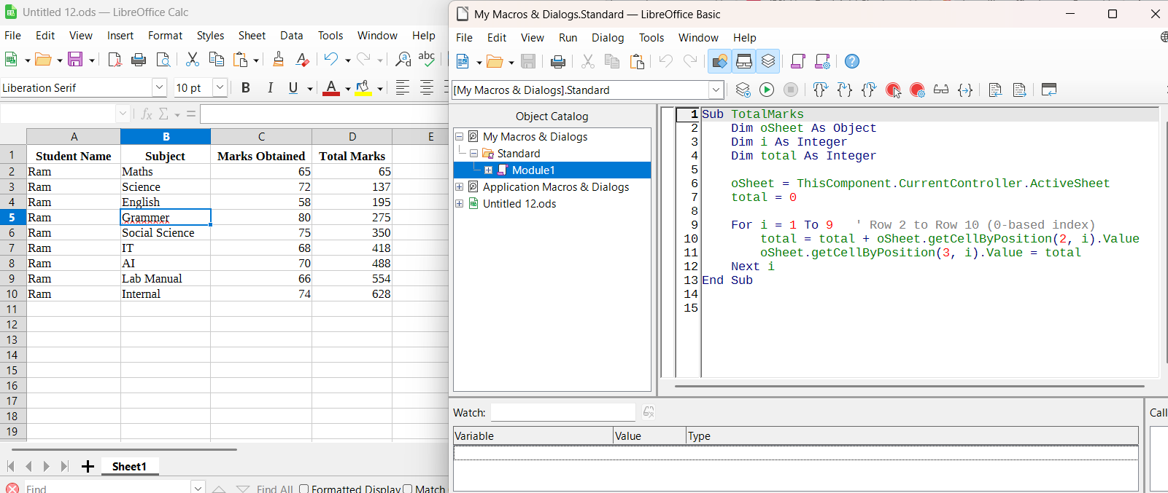
Q12 You are tasked with organising student marks data in a spreadsheet and automating the calculation of total marks using a macro named “TotalMarks”.
Set up a spreadsheet with three columns: Student Name in column A, Subject in column B, and Marks Obtained in column C. Ensure data starts from row 2.
Develop a macro named “TotalMarks” that iterates through each row of the spreadsheet (starting from row 2) to calculate the total marks obtained by each student.
For each student, sum up the marks obtained from all subjects listed.
Display the total marks for each student in column D, starting from row 2.
Execute the macro to automatically calculate and populate the total marks for each student based on the data provided in the spreadsheet.
Software: LibreOffice Calc
Step 1: Open LibreOffice Calc and create a new spreadsheet.
Step 2: In Row 1, enter the headings:
A1: Student Name
B1: Subject
C1: Marks Obtained
D1: Total Marks

Slide 23
Step 4: Click on Tools → Macros → Organize Macros → LibreOffice Basic.
Step 5: Create a new module and write a macro named TotalMarks.
Step 6: Program the macro to read marks from Column C and calculate the cumulative total of all subjects.
Step 7: Display the calculated total marks in Column D for each row.
Step 8: Save and close the Macro editor.
Step 9: Run the macro using Tools → Macros → Run Macro and select TotalMarks.
Result
The total marks of the single student across all subjects are calculated automatically.
Conclusion
The macro TotalMarks is used to calculate the total marks of one student studying multiple subjects.
Q13 You have received two versions of a financial report from different teams. You need to identify discrepancies and reconcile the differences between the two sheets. How would you do this task in LibreOffice Calc?
Answer
To identify and reconcile discrepancies between two versions of a financial report, both sheets are opened in LibreOffice Calc. The Compare Document feature is used to compare the two reports and highlight differences. The Track Changes option helps in reviewing all modifications made in the sheets. Required changes are accepted and incorrect entries are rejected to reconcile the data. Finally, the corrected spreadsheet is saved to ensure accuracy and consistency in the financial report.

Slide 24
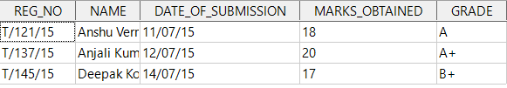
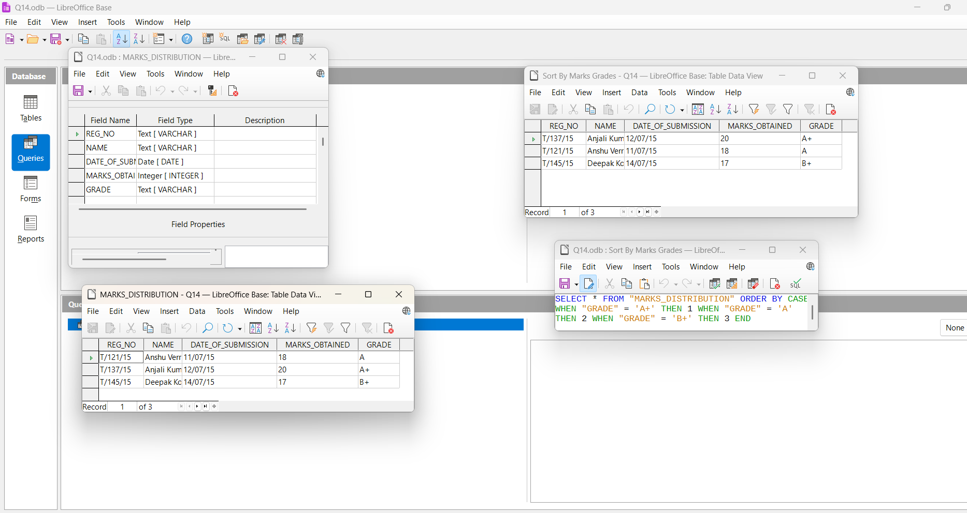
Q14 Create the following table using the Design View in LibreOffice Base:
Name the table as “MARKS_DISTRIBUTION”.
Enter at least three records in the table.
Sort the data on the basis of grades.
Step 1:
Open LibreOffice Base.
Step 2:
Click File → New → Database.
Step 3:
Select Create a new database → Click Next → Click Finish.
Save the database (e.g., Q14.odb).
Steps to Create Table Using Design View
Step 4:
Click on Tables in the left panel.

Slide 25
Step 5:
Click Create Table in Design View.
Step 6:
Enter the following fields and data types:
REG_NO – Text [VARCHAR]
NAME – Text [VARCHAR]
DATE_OF_SUBMISSION – Date [DATE]
MARKS_OBTAINED – Integer [INTEGER]
GRADE – Text [VARCHAR]
Step 7:
Set REG_NO as the Primary Key.
Step 8:
Save the table with the name MARKS_DISTRIBUTION.
Step 9:
Open the table and enter the given records.
Steps to Create Query Using SQL View
Step 10:
Click on Queries in the left panel.
Step 11:
Click Create Query in SQL View.
Step 12:
Type the following SQL command:
SELECT *
FROM "MARKS_DISTRIBUTION"
ORDER BY
CASE
WHEN "GRADE" = 'A+' THEN 1
WHEN "GRADE" = 'A' THEN 2
WHEN "GRADE" = 'B+' THEN 3
END;
Step 13: Click the Run (▶) button to execute the query.
Step 14: The records are displayed in sorted order based on grades.
Step 15: Save the query with a suitable name (e.g., Sort_By_Grade).
Final Result :- The data is sorted according to grade priority instead of alphabetical order.

Slide 26
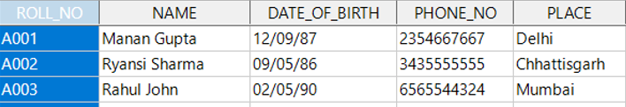
Q15 Create the following table using the Design View.
Perform the following operations:
Sort the Place in decreasing order.
Set Roll No. as the Primary Key.
Delete the record A002.
Add another record to the table.
Step 1: Open LibreOffice Base
Open LibreOffice.
Click on Base.
Select Create a new database → Click Finish.
Save the database as Q15.odb.
Step 2: Create Table using Design View
Click on Tables from the left panel.
Click Create Table in Design View.
Enter the following fields:
Field Name | Field Type
ROLL_NO | Text (VARCHAR)
NAME | Text (VARCHAR)
DATE_OF_BIRTH | Date (DATE)
PHONE_NO | Text (VARCHAR)
PLACE | Text (VARCHAR)
Step 3: Set Primary Key
Right-click on ROLL_NO.
Click Primary Key.
A key icon will appear next to ROLL_NO.

Slide 27
Step 4: Save the Table
Press Ctrl + S.
Name the table as STUDENTS.
Click OK.
Step 5: Enter Records
Enter the following records in Table Data View:
Roll No | Name | Date of Birth | Phone No | Place
A001 | Manan Gupta | 12/09/1987 | 2354667667 | Delhi
A002 | Ryansh Sharma | 09/05/1986 | 3435555555 | Chhattisgarh
A003 | Rahul John | 02/05/1990 | 6565544324 | Mumbai
Step 6: Sort Place in Decreasing Order (SQL Query)
Click on Queries → Create Query in SQL View.
Write the following SQL command:
SELECT * FROM "STUDENTS" ORDER BY "PLACE" DESC;
Click Run Query.
Save the query as place in decreasing order.
Step 7: Delete Record with Roll No A002
Click Tools → SQL.
Enter the following command:
DELETE FROM "STUDENTS" WHERE "ROLL_NO" = 'A002';
Click Execute.
The record A002 will be deleted successfully.
Step 8: Add a New Record
1.Again open Tools → SQL.
2.Write the following SQL command:
INSERT INTO "STUDENTS" ("ROLL_NO", "NAME","DATE_OF_BIRTH", "PHONE_NO", "PLACE") VALUES ('A004','Toshi Dubey', '1992-03-18', '9876543210', 'Indore');
3.Click Execute.

Slide 28
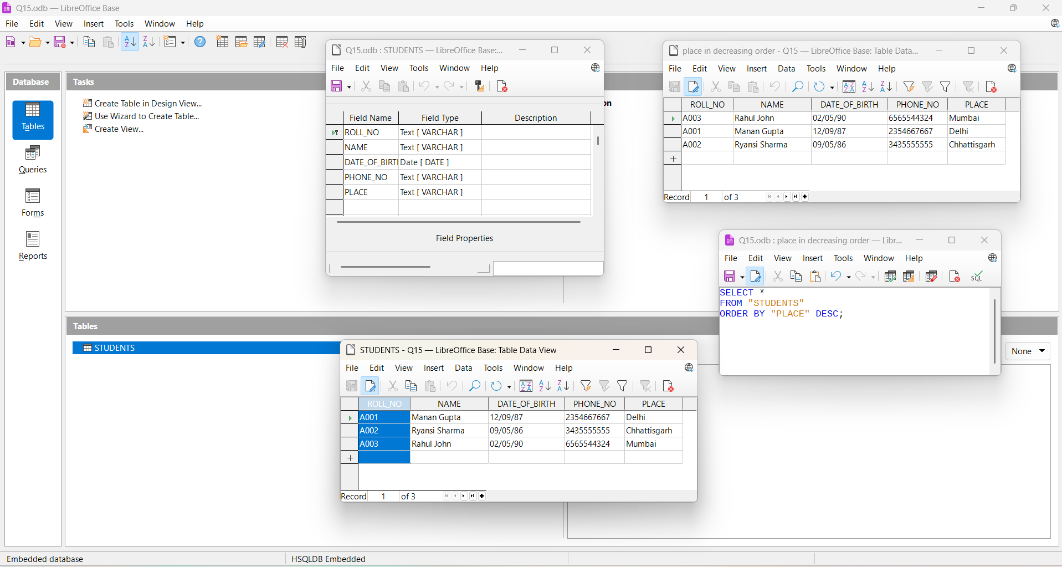
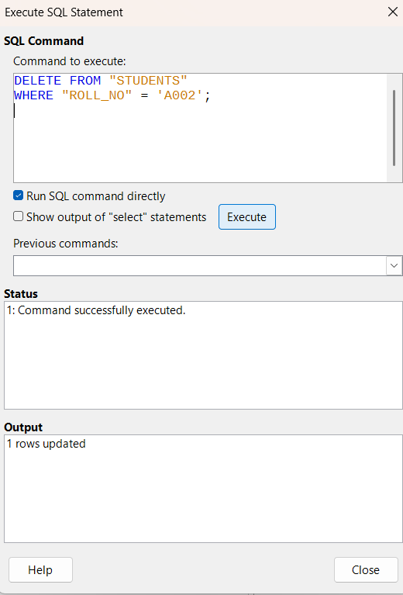
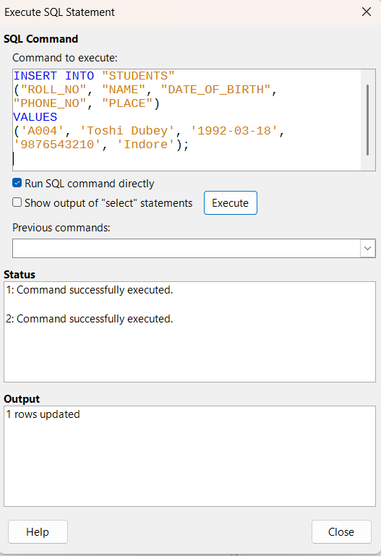
Final Result
The table now contains:
Primary Key set on ROLL_NO
Records sorted by Place in decreasing order
Record A002 deleted
New record A004 added

Slide 29
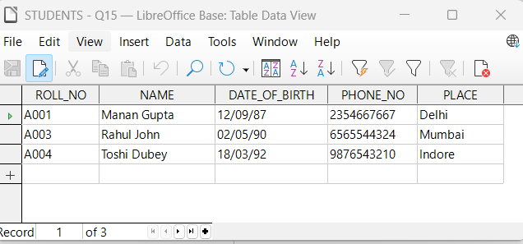
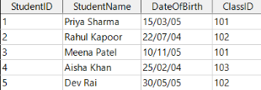

Q16 You are a school database that includes two main tables: Students and Classes.
Students Table
Classes Table
Set up a relationship between the Students table and the Classes table.
Write a query to list all students along with the class they are in and the teacher of that class.

Slide 30
Step 1: Create a New Database
Open LibreOffice Base.
Click Create a new database → Next → Finish.
Save the database as Q16.odb.
Step 2: Create CLASSES Table using Design View
Click Tables → Create Table in Design View.
Enter the following fields:
Field Name | Field Type
ClassID | Integer
ClassName | Text (VARCHAR)
TeacherName | Text (VARCHAR)
Set ClassID as Primary Key.
Save the table as CLASSES.
Step 3: Create STUDENTS Table using Design View
Click Tables → Create Table in Design View.
Enter the following fields:
Field Name | Field Type
StudentID | Integer
StudentName | Text (VARCHAR)
DateOfBirth | Date
ClassID | Integer
Set StudentID as Primary Key.
Save the table as STUDENTS.
Step 4: Enter Records in Both Tables
Enter records in CLASSES table (Mathematics, Science, History with teachers).
Enter records in STUDENTS table with proper ClassID values.
Step 5: Create Relationship between Tables
Click Tools → Relationships.
Add CLASSES and STUDENTS tables.
Drag ClassID from CLASSES to ClassID in STUDENTS

Slide 31
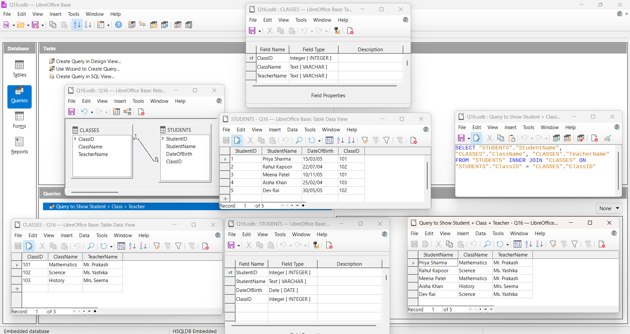
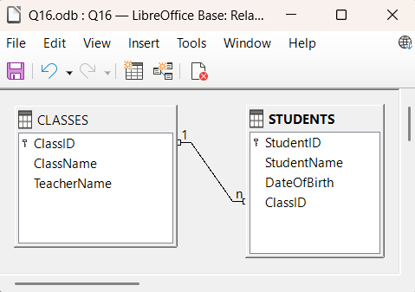
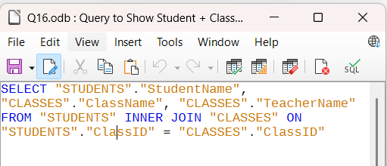
A one-to-many relationship (1:n) is created.
Save and close the relationship window.
Step 6: Create Query using SQL View
Click Queries → Create Query in SQL View.
Type the following SQL command:
SELECT "STUDENTS"."StudentName", "CLASSES"."ClassName", "CLASSES"."TeacherName" FROM "STUDENTS" INNER JOIN "CLASSES" ON "STUDENTS"."ClassID" = "CLASSES"."ClassID";
Click Run Query (F5).
Step 7: Save the Query
Save the query as
Query to Show Student + Class + Teacher.

Slide 32
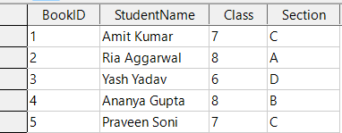
Q17 Create the following table for the Students’ Details:
Create a form for the Students’ Details table.
Enter the following records through the form.
BookID | StudentName | Class | Section
6 | Gyan Shankar | 8 | B
7 | Richa Sinha | 6 | A
Step 1: Create Database
Open LibreOffice Base.
Select Create a new database → Click Next → Finish.
Save the database as Q17.odb.
Step 2: Create Table in Design View
Click Tables → Create Table in Design View.
Create the following fields:
Field Name | Field Type
BookID | Integer (AutoValue = Yes, Primary Key)
StudentName | Text (VARCHAR)
Class | Integer
Section | Text (VARCHAR)
Set BookID as Primary Key and AutoValue = Yes.
Save the table as STUDENTS_DETAILS.

Slide 33
Step 3: Insert Records in Table
Enter the following records (BookID will be auto-generated):
StudentName | Class | Section
Amit Kumar | 7 | C
Ria Aggarwal | 8 | A
Yash Yadav | 6 | D
Ananya Gupta | 8 | B
Praveen Soni | 7 | C
Step 4: Create Form
Click Forms → Use Wizard to Create Form.
Select table STUDENTS_DETAILS.
Move all fields to selected fields.
Click Next → Next and choose Columnar Layout.
Click Finish and save the form as STUDENTS_FORM.
Step 5: Enter Records Through Form
Using STUDENTS_FORM, add the following records:
StudentName | Class | Section
Toshi Dubey | 10 | A
Sanskar Parihar | 10 | A
(BookID is generated automatically starting from 1)
Step 6: Result
All records are successfully entered through the form and BookID is auto-generated.
Conclusion
The Students’ Details table was created using Design View, a form was designed using Form Wizard, and records were entered successfully through the form.

Slide 34
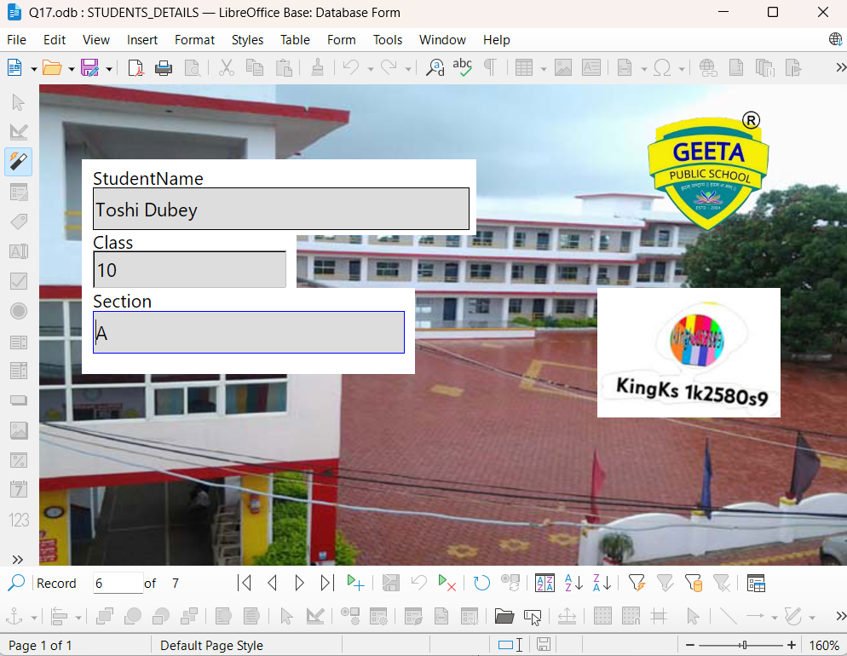

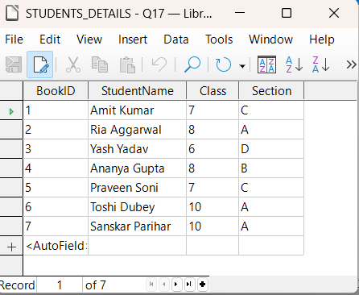

Slide 35
Q18. Consider the following spreadsheet:
Product | Units Sold
A | 69
B | 73
C | 88
D | 82
Average Unit Sold is calculated in cell B8.
Calculate the average units sold in cell B8.
Maximise the average number of units sold to 95 using Goal Seek.
The criteria for maximising the average number of units sold is as follows:
  B2 <= 88
  B3 >= 82
  B4 <= 90
  B5 >= 60
Step 1: Enter the data
Open LibreOffice Calc.
Enter Units Sold values in column B:
  B2 = 69
  B3 = 73
  B4 = 88
  B5 = 82
Step 2: Calculate the Average
In cell B8, enter:
=AVERAGE(B2:B5)
Press Enter.
Initial average = 78.
Step 3: Apply Goal Seek
Go to Tools → Goal Seek.
Fill the dialog box:
  Formula cell: $B$8
  Target value: 95

Slide 36
  8.Variable cell: B2
Click OK.
👉 LibreOffice Calc changes the value of B2.
👉 Average becomes 95.
Step 4: Verify the Conditions
Now check the given conditions:
B2 ≤ 88 ❌ (B2 becomes greater than 88)
B3 ≥ 82 ❌ (B3 is still 73)
B4 ≤ 90 ✔️
B5 ≥ 60 ✔️
Important Observation
✔️ The average value 95 is achieved
❌ But all the given conditions are NOT satisfied
Goal Seek changes only one cell, ignoring the remaining constraints.
PROOF (Why conditions are violated)
Reason 1: Single-variable limitation
Goal Seek works on only one variable cell at a time
It does not enforce multiple conditions simultaneously
Reason 2: Mathematical contradiction
To maintain all conditions, maximum possible values are:
B2 = 88
B3 = 82
B4 = 90
B5 = 60
Maximum possible average:
(88 + 82 + 90 + 60) ÷ 4 = 80
But achieved average is: 95
Therefore, reaching 95 automatically breaks at least one condition.

Slide 37
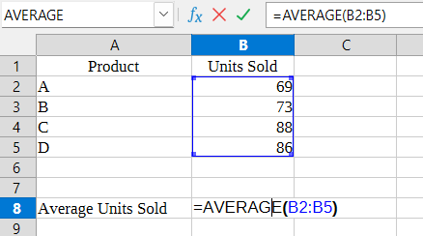
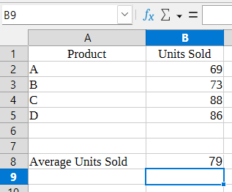
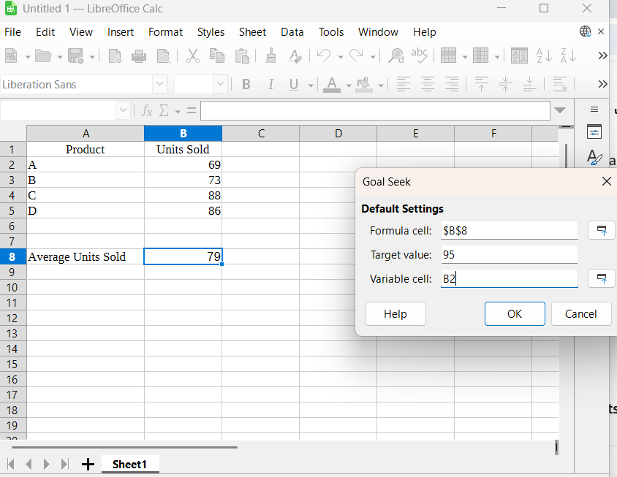
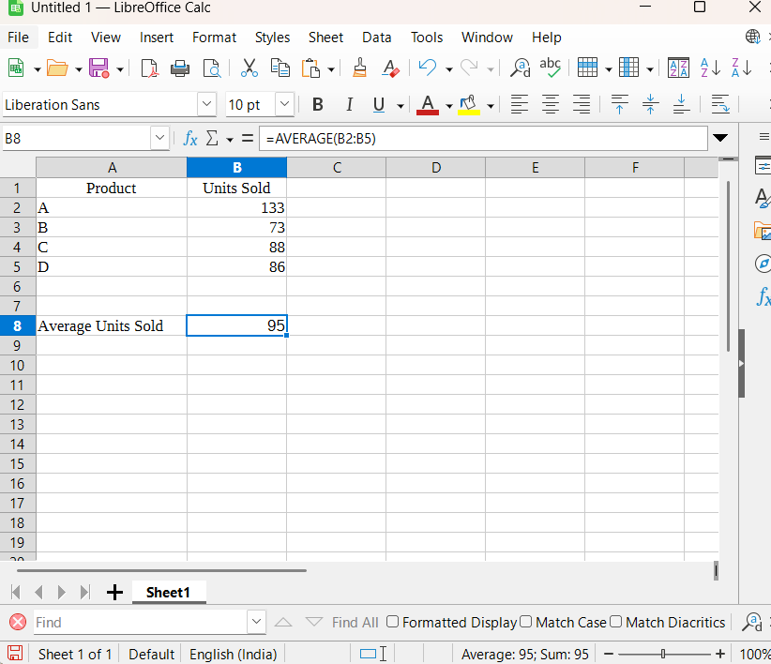

Slide 38
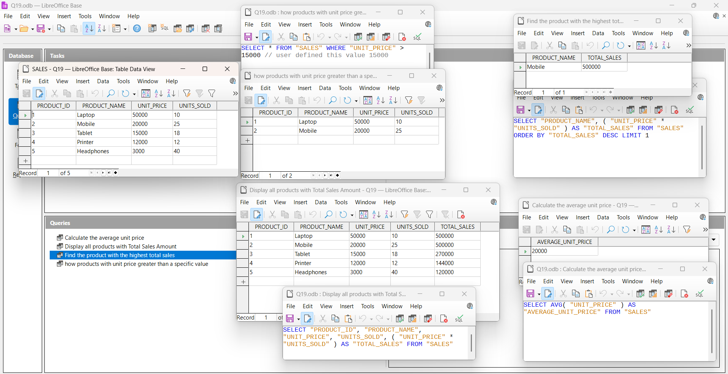
Q19 Create a table named Sales with the columns: product_id, product_name, unit_price, and units_sold.
Insert some sample data into the Sales table. You can include at least 5 different products with varying prices and unit sales.
Display all products and their total sales amount (unit_price × units_sold).
Find the product with the highest total sales amount.
Show all products with a unit price greater than a specific value (user input).
Calculate the average unit price across all products.
Step 1: Create a New Database
Open LibreOffice → Base
Select Create a new database
Click Finish
Save the file as Q19.odb
Step 2: Create Table in Design View
Click Tables → Create Table in Design View
Enter the following fields:

Slide 39
Field Name | Field Type
PRODUCT_ID | Integer
PRODUCT_NAME | Text (VARCHAR)
UNIT_PRICE | Integer
UNITS_SOLD | Integer
Set PRODUCT_ID as Primary Key
Save table as SALES
Step 3: Insert Sample Data
Enter at least 5 records, for example:
PRODUCT_ID | PRODUCT_NAME | UNIT_PRICE | UNITS_SOLD
1 | Laptop | 50000 | 10
2 | Mobile | 20000 | 25
3 | Tablet | 15000 | 18
4 | Printer | 12000 | 12
5 | Headphones | 3000 | 40
Queries (SQL View)
Step 4: Display All Products with Total Sales
Click Queries → Create Query in SQL View
Write:
SELECT "PRODUCT_ID", "PRODUCT_NAME", "UNIT_PRICE", "UNITS_SOLD", ("UNIT_PRICE" * "UNITS_SOLD") AS "TOTAL_SALES" FROM "SALES";
Click Run
Save as Display Total Sales
Step 5: Find Product with Highest Total Sales
Create new SQL Query
Write:

Slide 40
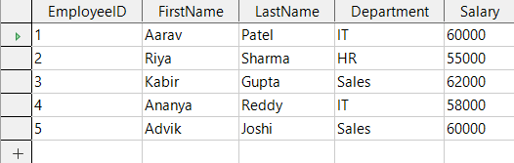
SELECT "PRODUCT_NAME", ("UNIT_PRICE" * "UNITS_SOLD") AS"TOTAL_SALES" FROM "SALES" ORDER BY "TOTAL_SALES" DESCLIMIT 1; ​
Run and save as Highest Total Sales​
Step 6: Show Products with Unit Price Greater Than a Value​
(Example: greater than 15000)​
SELECT * FROM "SALES" WHERE "UNIT_PRICE" > 15000; ​
Save as Unit Price Greater Than Value​
Step 7: Calculate Average Unit Price​
Create new SQL Query​
Write:​
SELECT AVG("UNIT_PRICE") AS "AVERAGE_UNIT_PRICE" FROM"SALES"; ​
Run and save as Average Unit Price​
Q20 Consider the following Employee table.
Create a report using the Employee table.
Format the report according to the requirement.
Add the page number in the footer of the report.
Step 1: Open LibreOffice Base
Open LibreOffice Base.
Open your database file Q20.odb.
Step 2: Create the EMPLOYEE Table
Click on Tables → Create Table in Design View.
Create the following fields:

Slide 41
Field Name | Data Type
EmployeeID | Integer (Primary Key)
FirstName | Text (VARCHAR)
LastName | Text (VARCHAR)
Department | Text (VARCHAR)
Salary | Integer
Set EmployeeID as Primary Key.
Save the table as EMPLOYEE.
Step 3: Insert Records into EMPLOYEE Table
Open the table and insert the following records:
EmployeeID | FirstName | LastName | Department | Salary
1 | Aarav | Patel | IT | 60000
2 | Riya | Sharma | HR | 55000
3 | Kabir | Gupta | Sales | 62000
4 | Ananya | Reddy | IT | 58000
5 | Advik | Joshi | Sales | 60000
Save and close the table.
Step 4: Create Report Using Wizard
Click on Reports → Use Wizard to Create Report.
Select table EMPLOYEE.
Move all fields to the right:
  EmployeeID
  FirstName
  LastName
  Department
  Salary
Click Next.
No grouping → Next.

Slide 42
Sorting not required → Next.
Select layout Tabular.
Orientation Portrait.
Click Finish.
Save report as EMPLOYEE_REPORT.
Step 5: Open Report in Design View
Right-click on EMPLOYEE_REPORT.
Select Edit.
Step 6: Format the Report
Increase font size of field labels.
Make field names Bold.
Align text properly in Detail section.
Insert logo image in Page Header (as shown).
Step 7: Add Page Number in Footer
Click on Page Footer section.
Insert a Label Field.
Type the following expression:
="Page " & PageNum
Align it to the center.
Step 8: Save and View Report
Save the report.
Click View Report.
Verify:
  All employee records are shown.
  Formatting is correct.
  Page number appears at the bottom.
  Final Output
A properly formatted Employee Report
Uses EMPLOYEE table
Includes Page Number
Matches the given question exactly

