Slide 1



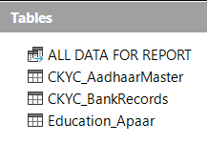
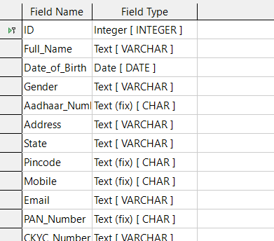
KINGKS ECOSYSTEM PROJECT
School: Geeta Public School
Class: X (CBSE)
Section: 10th C
Roll Number: 13
Guided By: Sukhwinder Singh Sir
1. Introduction
This project titled 'KingKs Ecosystem Project' is developed using LibreOffice Base. The objective of this project is to understand how a centralized database system can manage Aadhaar, PAN, Bank, and Education (APAAR) details efficiently.
2. Tools & Technology Used
- LibreOffice Base (HSQLDB Embedded)
- Tables, Queries, Forms, Reports
- SQL Views for data merging
- Microsoft Word (for documentation)
3. Database Design
The project consists of three main tables:
1. CKYC_AadhaarMaster:
Stores Aadhaar, PAN, personal, and contact details.
2. CKYC_BankRecords:
Stores bank details like account number, IFSC code, account type, and Aadhaar seeding status.
3. Education_Apaar:
Stores education details including school/college, board, percentage, APAAR ID, degree, and university.
Steps to Create a Table in Design View (LibreOffice Base)
Open LibreOffice Base
Start LibreOffice and open your existing database file or create a new database.
Go to Tables Section
In the left panel, click on Tables.
Select “Create Table in Design View”
From the Tasks pane, click on Create Table in Design View.
Enter Field Names
In the Field Name column, type the required field names one by one
(example: ID, Full_Name, Aadhaar_Number, Mobile, etc.).
Choose Field Types
In the Field Type column, select appropriate data types such as:
  Text (VARCHAR)
  Integer
  Date
  Decimal
LibreOffice Base

Slide 2
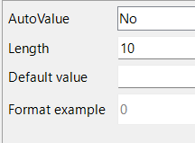
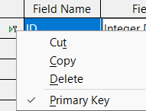

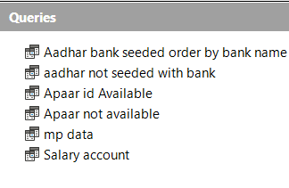
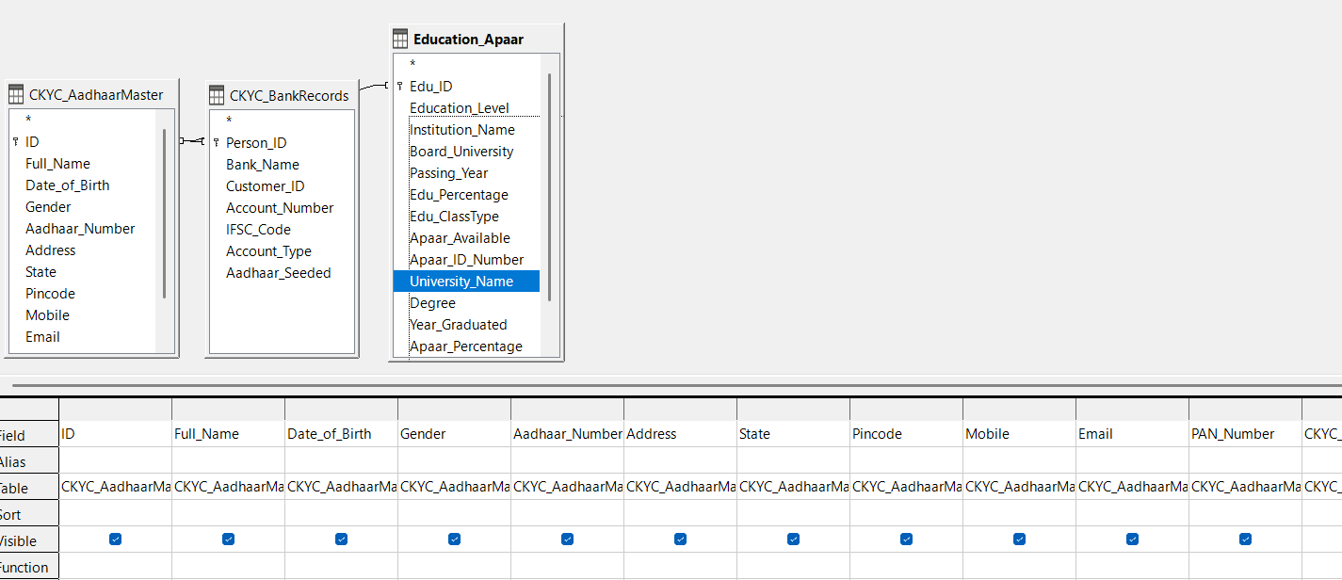
Set Field Properties
In the lower Field Properties section, define:
  Length
  Default Value
  Required (Yes/No)
  AutoValue (if needed)
Set Primary Key
Select the ID field, right-click and choose Primary Key to uniquely identify each record.
Save the Table
Click Save, give a suitable table name (e.g., CKYC_AadhaarMaster), and press OK.
Switch to Data View
After saving, open the table to enter records in Data View.
4. Data Records
A total of 500 dummy records were created for this project to simulate real-world data handling and reporting.
5. Queries & Views
Queries
Queries are used to retrieve specific information from one or more tables based on conditions.
In this project, queries help in analyzing Aadhaar, Bank, and Education data separately and together.
Created By SQL Codes
Queries Created in the Project
Aadhaar bank seeded order by bank name
Displays records where Aadhaar is seeded with bank accounts,
sorted by bank name.
Aadhaar not seeded with bank
Shows bank accounts where Aadhaar seeding status is “No”.
APAAR ID Available
Displays students whose APAAR ID is available.
APAAR Not Available
Displays records where APAAR ID is not available.
Salary Account Holders
Shows records having salary account type.
State-wise Data Query
Retrieves data based on state selection for analysis.
These queries help in filtering data and preparing reports efficiently.
Views
What is a View?
A View is a virtual table created using an SQL query.
It does not store data but combines data from multiple tables for easy reporting.

Slide 3
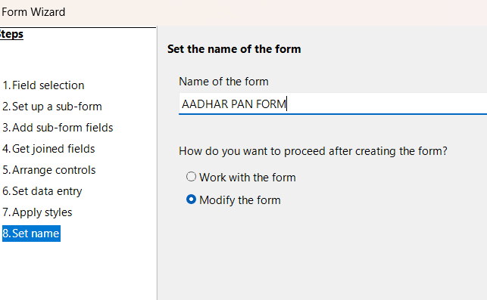
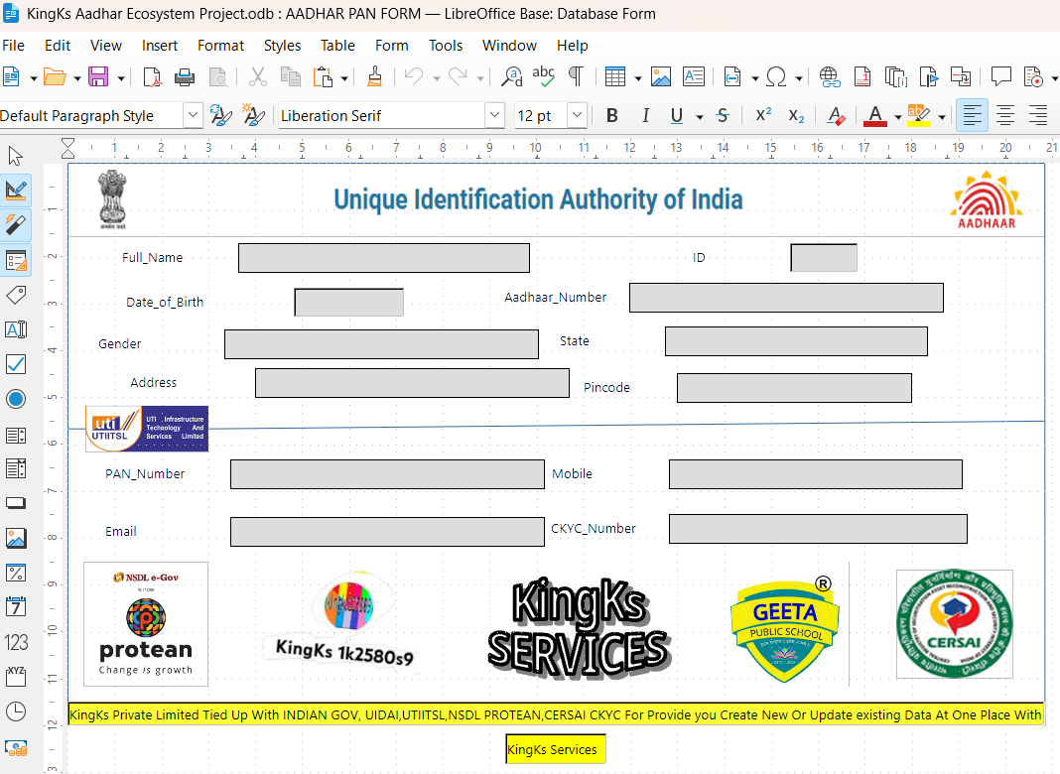
🔗 Connecting 3 Tables in One View for Report Generation
To generate a complete report, a VIEW was created by connecting the following three tables:
CKYC_AadhaarMaster
(Aadhaar, PAN, personal details)
CKYC_BankRecords
(Bank account and Aadhaar seeding details)
Education_Apaar
(Education and APAAR details)
Common Key Used for Connection
ID / Person_ID / Edu_ID
These fields act as a link between tables so that data of the same person can be merged correctly.
A special VIEW named 'ALL DATA FOR REPORT' was created by merging Aadhaar, PAN, Bank, and Education tables for final reporting.
6. Forms
Steps to Create Form Using Wizard View (with Modify Option)
Open LibreOffice Base
Open the KingKs Ecosystem Project database
file.
Go to Forms Section
Click on Forms from the left panel.
Select “Use Wizard to Create Form”
In the Tasks pane, click on Use Wizard to Create
Form.
Choose Table or Query
Select the required Table or View (e.g., CKYC_AadhaarMaster) from the list.
Select Fields
Move required fields from Available fields to Fields in the form using the >> button.
Click Next (Subform Selection)
Choose No subform (for main Aadhaar form) or Yes, add subform (for bank & education forms).
Choose Layout of Controls
Select a suitable layout such as Columnar – Labels Left.
Set Data Entry Mode
Choose:
  The form is to display all data
  Allow modification of existing records
Apply Styles
Select a form style and background color.
Choose Modify Form Option
Select Modify the form and click Finish.
Modifying the Form in Design View
After clicking Finish, the form opens in Design View where:
Labels are aligned properly
Text boxes are resized
Logos and headings are added
Professional layout is designed
🔁 Creating Form with Subform (Bank & Education Records)
Purpose of Subform
Subforms are used to show related data from another table linked with the main form.
7. Reports
Reports were generated using merged data views to display complete information of individuals including Aadhaar, PAN, Bank, and Education details.
8. Conclusion
This project helped me understand database concepts like tables, queries, forms, views, and reports. It also enhanced my skills in data management and presentation.

Slide 4
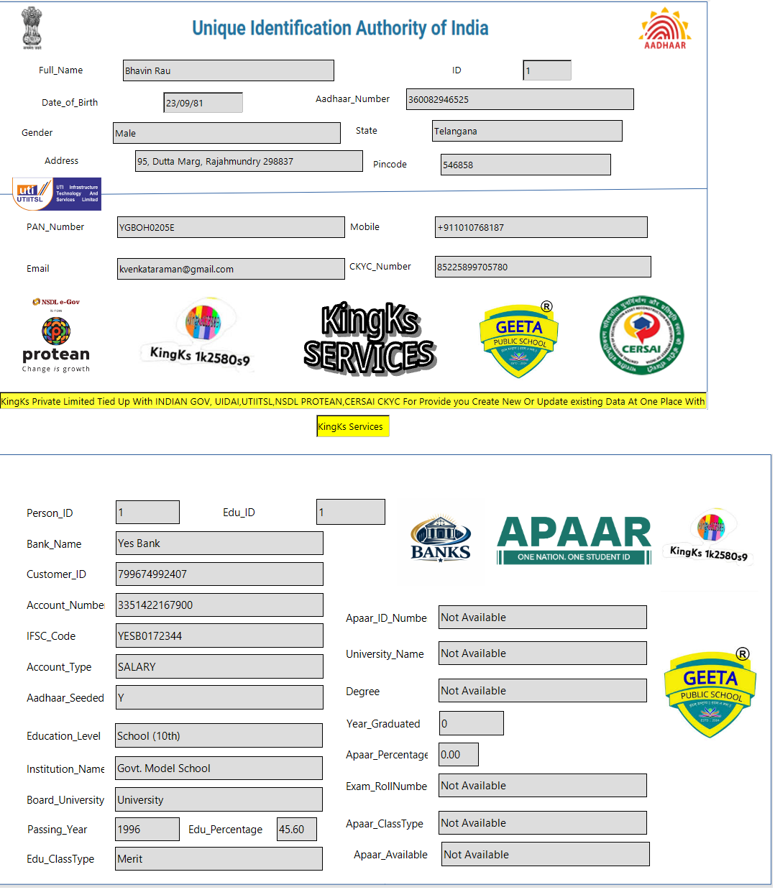

Slide 5
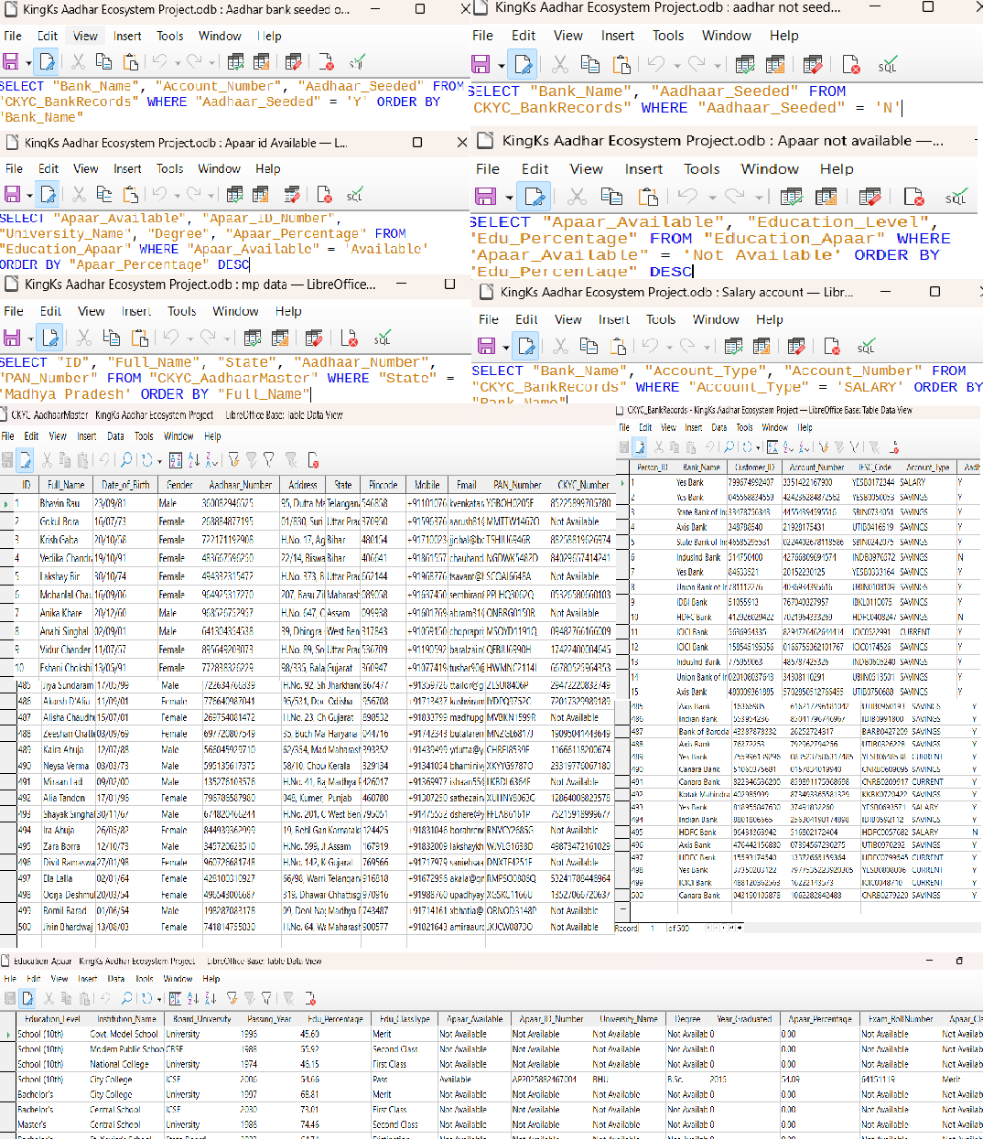

Slide 6
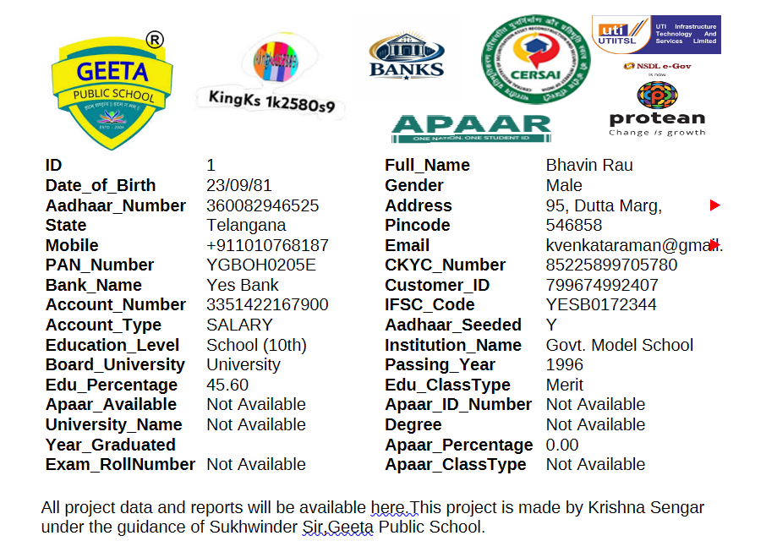
THIS REPORT CONTAINS DATA OF 500 INDIVIDUALS.
📄 Declaration
I hereby declare that this project titled “Kingks Ecosystem Project” is my original work and has been completed by me using LibreOffice Base.
The information used in this project is created for educational purposes only and does not contain any real personal data.
I have completed this project under the guidance of Mr. Sukhwinder Singh Sir and have not copied it from any other source.
Student Name: Krishna Sengar
Class: X (CBSE)
Section: C
Roll Number: 13
School: Geeta Public School
Signature: ____________
Date: ____________
📜 Certificate
This is to certify that Krishna Sengar, student of Class X (CBSE), Section C, RollNumber 13,of Geeta Public School, has successfully completed the project titled “KingksEcosystemProject” using LibreOffice Base under my guidance and supervision.
This project is an original work and has been completed as per the CBSEcurriculumrequirements. The student has shown sincere effort, dedication, and interest incompleting theproject.
I wish him all the best for his future endeavors.
Teacher’s Name: Mr. Sukhwinder Singh
Subject Teacher: Computer Applications / IT
School: Geeta Public School
Teacher Sign
____________
SCHOOL STAMP
________

