Slide 1

GEETA PUBLIC SCHOOL
CAFE MANAGEMENT SYSTEM
STUDENT NAME: DIVYANSH RAJAWAT
CLASS & SECTION: 10 – A
ROLL NUMBER: 11
SCHOOL NAME: GEETA PUBLIC SCHOOL
SUBJECT TEACHER: SUKHWINDER SINGH SOHAL SIR
SUBJECT: INFORMATION TECHNOLOGY / COMPUTER APPLICATIONS
ACKNOWLEDGEMENT
I WOULD LIKE TO EXPRESS MY SINCERE GRATITUDE TO MY RESPECTED TEACHER MR. SUKHWINDER SINGH SOHAL SIR FOR HIS VALUABLE GUIDANCE, CONSTANT SUPPORT, AND ENCOURAGEMENT THROUGHOUT THE COMPLETION OF THIS PROJECT.
I ALSO THANK MY SCHOOL, GEETA PUBLIC SCHOOL, FOR PROVIDING THE NECESSARY RESOURCES AND A CONDUCIVE ENVIRONMENT FOR LEARNING.
THIS PROJECT HELPED ME UNDERSTAND DATABASE CONCEPTS PRACTICALLY AND ENHANCED MY KNOWLEDGE AND SKILLS IN INFORMATION TECHNOLOGY.
— Divyansh Rajawat

Slide 2
GEETA PUBLIC SCHOOL
CERTIFICATE
THIS IS TO CERTIFY THAT DIVYANSH RAJAWAT, A STUDENT OF CLASS X – A (ROLL NO. 11) OF GEETA PUBLIC SCHOOL, HAS SUCCESSFULLY COMPLETED THE PROJECT TITLED “CAFE MANAGEMENT SYSTEM” AS A PART OF THE CBSE CURRICULUM.
THE PROJECT HAS BEEN DESIGNED AND DEVELOPED USING LIBREOFFICE DATABASE (BASE), AND THROUGH THIS PROJECT, THE STUDENT HAS GAINED PRACTICAL KNOWLEDGE AND MASTERED THE BASIC CONCEPTS OF LIBREOFFICE DATABASE MANAGEMENT, INCLUDING TABLES, FORMS, QUERIES, AND REPORTS.
THIS PROJECT IS AN ORIGINAL WORK CARRIED OUT UNDER THE VALUABLE GUIDANCE AND SUPERVISION OF MR. SUKHWINDER SINGH SOHAL SIR, SUBJECT TEACHER, INFORMATION TECHNOLOGY / COMPUTER APPLICATIONS.
WE APPRECIATE THE EFFORTS AND DEDICATION SHOWN BY THE STUDENT DURING THE COMPLETION OF THIS PROJECT.
DATE: ____________________
TEACHER’S SIGNATURE:
____________________
SCHOOL STAMP
_________________

Slide 3

1. INTRODUCTION
A Cafe Management System is a computerized system used to manage café operations such as menu handling and staff management.
In this project, LibreOffice Base is used to create a structured database consisting of tables, queries, forms, and reports.
2. OBJECTIVE OF THE PROJECT
To manage café menu digitally
To store staff details securely
To retrieve information using SQL queries
To understand database concepts practically
To reduce paperwork and human errors
3. CAFE MANAGEMENT SYSTEM AS AN ECOSYSTEM
The Cafe Management System works like an ecosystem, where different components interact with each other:
Tables → Store raw data (Menu & Staff)
Queries → Process and filter data
Forms → Provide user-friendly data entry
Reports → Generate printable outputs
All components work together to make the system efficient, organized, and reliable—just like a real-world management ecosystem.
LibreOffice
Base

Slide 4
4. TOOLS & SOFTWARE USED
Software: LibreOffice Base
Database Type: Embedded HSQLDB
Operating System: Windows
Language Used: SQL (Structured Query Language)
5. DATABASE DESIGN
The database contains two main tables:
Menu
staff_fullinfo
These tables are connected logically and store all café-related data.
Table 1: Menu
Field Name | Data Type | Description
Item no | Integer | Unique item number
Item name | Text | Name of food item
Item price | Integer | Price
Category | Text | Food category
THE MENU TABLE STORES INFORMATION ABOUT ALL FOOD AND DRINK ITEMS AVAILABLE IN THE CAFE.
IT CONTAINS FIELDS SUCH AS ITEM NO, ITEM NAME, ITEM PRICE, AND CATEGORY.
ITEM NO UNIQUELY IDENTIFIES EACH ITEM, WHILE ITEM PRICE IS USED FOR BILL CALCULATION.
CATEGORY HELPS IN CLASSIFYING ITEMS LIKE BREAKFAST, MAIN COURSE, FAST FOOD, SWEETS, AND DRINKS.

Slide 5
TABLE 2: STAFF_FULLINFO
Field Name | Data Type | Description
ID | Integer | Staff ID
Name | Text | Staff name
Profession | Text | Job role
Salary | Integer | Salary
Phone | Text | Contact number
Address | Text | Address
Joining Date | Date | Date of joining
Shift | Text | Morning / Evening / Night
Status | Text | Active / Inactive
Age | Integer | Age
Gender | Text | Gender
Aadhar | Text | Aadhar number
Email | Text | Email
Emergency Contact | Text | Emergency phone
Salary Type | Text | Daily / Monthly
THE STAFF TABLE STORES COMPLETE INFORMATION ABOUT THE EMPLOYEES WORKING IN THE CAFE.
IT CONTAINS DETAILS SUCH AS STAFF ID, NAME, PROFESSION, SALARY, AND CONTACT INFORMATION.
FIELDS LIKE SHIFT, STATUS, AND SALARY TYPE HELP IN MANAGING STAFF WORK SCHEDULES AND PAYMENTS.
JOINING DATE, AGE, AND GENDER PROVIDE PERSONAL AND EMPLOYMENT DETAILS OF STAFF MEMBERS.
THIS TABLE HELPS IN EFFECTIVE STAFF MANAGEMENT AND MAINTAINS PROPER EMPLOYEE RECORDS IN THE SYSTEM.

Slide 6
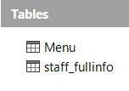
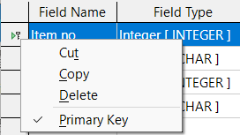
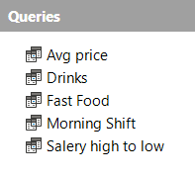
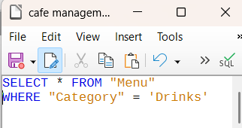
7. STEPS TO CREATE TABLES
OPEN LIBREOFFICE BASE.
CLICK ON TABLES FROM THE DATABASE WINDOW.
SELECT CREATE TABLE IN DESIGN VIEW.
ENTER THE REQUIRED FIELD NAMES AND DATA TYPES.
SET THE PRIMARY KEY FOR UNIQUE IDENTIFICATION.
SAVE THE TABLE.
NAME THE TABLES AS MENU AND STAFF_FULLINFO.
8. STEPS TO CREATE QUERIES
OPEN LIBREOFFICE BASE DATABASE.
CLICK ON QUERIES FROM THE LEFT PANEL.
SELECT CREATE QUERY IN SQL VIEW.
WRITE THE REQUIRED SQL COMMAND.
EXECUTE THE QUERY TO VIEW RESULTS.
SAVE THE QUERY FOR FUTURE USE.
🔹 Drinks Query
SELECT * FROM "Menu"
WHERE "Category" = 'Drinks';
🔹 Fast Food (Price > 150)
SELECT * FROM "Menu"
WHERE "Category" = 'Fast Food'
AND "Item price" > 150;

Slide 7
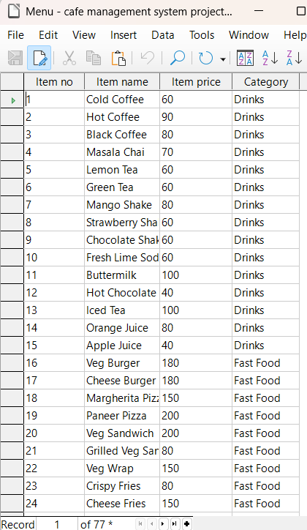
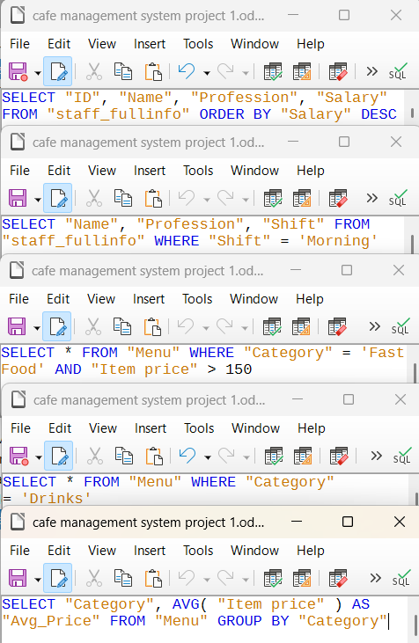
🔹 Average Price (Category-wise)
SELECT "Category", AVG("Item price") AS "Avg_Price"
FROM "Menu"
GROUP BY "Category";
🔹 Morning Shift Staff
SELECT "Name", "Profession", "Shift"
FROM "staff_fullinfo"
WHERE "Shift" = 'Morning';
🔹 Salary High to Low
SELECT "ID", "Name", "Profession", "Salary"
FROM "staff_fullinfo"
ORDER BY "Salary" DESC

Slide 8
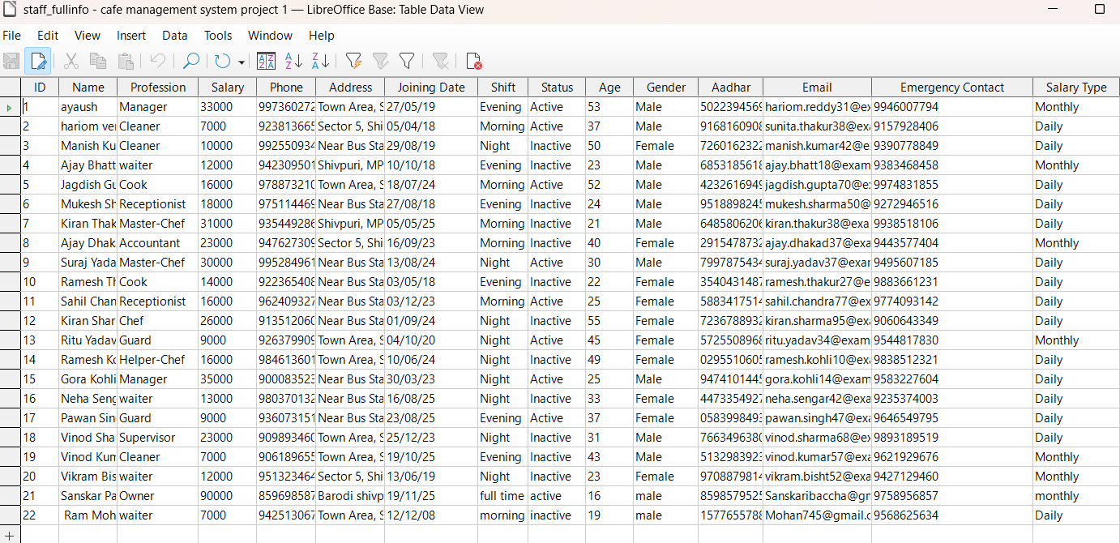
STEPS TO CREATE FORM (JOINING FORM)
A. Creating Main Form (Joining Form)
Step 1: Open Forms Section
Open your database file
cafe management system project 1.odb
Click on Forms in the left panel
Select Use Wizard to Create Form
Step 2: Select Table
From Tables, select staff_fullinfo
Move all fields (>>) to the selected fields area
Click Next
Step 3: Arrange Fields
Choose No subform at this stage
Click Next
Step 4: Data Entry Mode
Select Display all data
Allow Add / Modify / Delete records
Click Next

Slide 9
Step 5: Choose Layout
Select Columnar – Labels on Left
Click Next
Step 6: Apply Style
Choose any style (Default)
Click Next
Step 7: Name the Form
Enter form name as Joining
Select Modify the form
Click Finish
B. Designing the Form (To Match Your Image)
Step 8: Open Form in Design Mode
Right-click on Joining
Select Edit
Step 9: Adjust Field Boxes
Resize text boxes
Align fields properly
Change font size and color
Place fields in two columns (left & right)
Step 10: Add Background Image
Click Form → Page Style
Go to Background
Choose Bitmap
Select café image
Click OK
Step 11: Format Controls
Right-click on any text box → Control Properties
Change:
  Background color ,Border ,Font color
Repeat for all fields
Step 12: Save the Form
Click Save
Close design mode

Slide 10
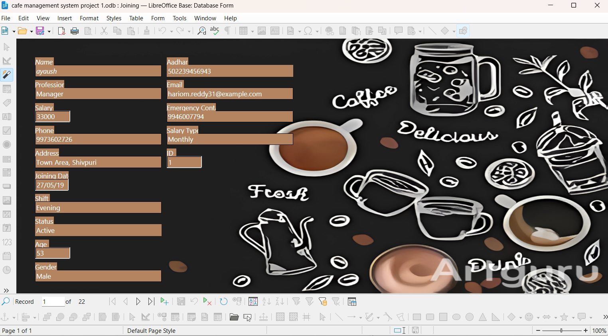
Creating Subform Using Wizard
Click Forms → Use Wizard to Create Form
Select staff_fullinfo as the main table and choose required fields → Next
Choose Add Subform → Next
Select Menu table and choose Item name, Item price, Category → Next
Choose No relationship → Next
Select Tabular layout → Next
Name the form Joining with Subform, select Modify the form → Finish
D. Positioning Subform in Design View
Resize and place the subform at the bottom or right side
Align properly
Click Save and exit design mode

Slide 11
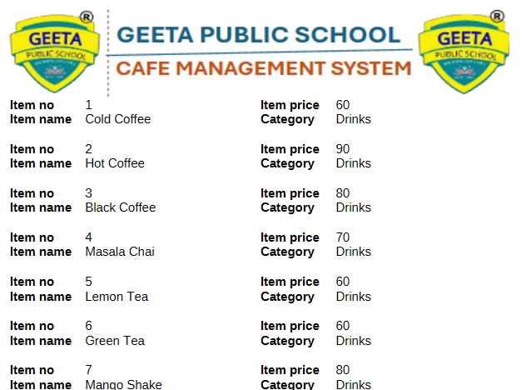
10. REPORTS
🔹 Steps to Create Report
Click on Reports from the left panel
Select Use Wizard to Create Report
Choose the required table (Menu or staff_fullinfo)
Select all required fields
Arrange fields as needed and click Next
Choose layout and style
Click Finish and save the report
🔹 Reports Created
Menu Report – Displays all menu items with price and category in printable format

Slide 12
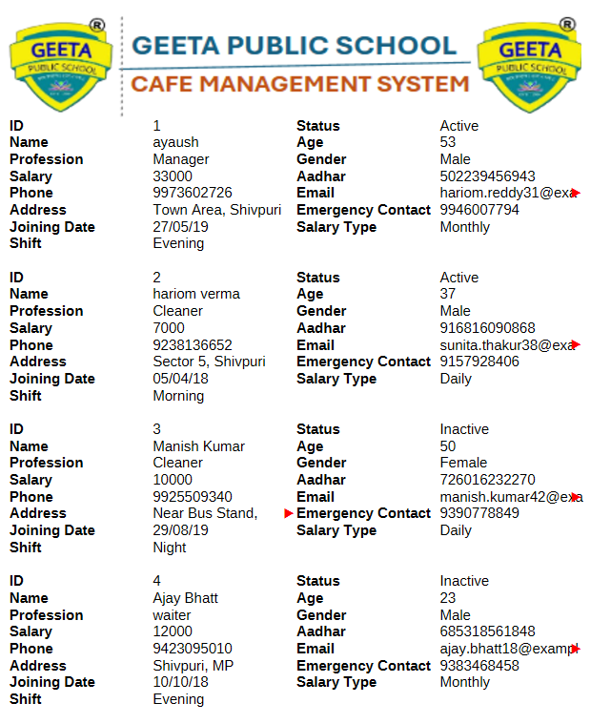
Staff Full Info Report – Displays complete staff details such as name, profession, salary, shift, and contact information

Slide 13
11. ADVANTAGES OF CAFE MANAGEMENT SYSTEM
Stores menu and staff data in an organized manner
Reduces paperwork and saves time
Provides fast and accurate data retrieval using queries
Easy data entry using forms
Generates printable reports for records
Improves efficiency and management of café operations
User-friendly and easy to use
12. CONCLUSION
The Cafe Management System developed using LibreOffice Base is an effective database solution for managing café-related information. This project helped me understand how tables, queries, forms, and reports work together in a real-life system. It improved my knowledge of database management and SQL queries. Overall, this project is useful, efficient, and fulfills the objectives of the CBSE Class 10 curriculum.
DIVYANSH RAJAWAT
CLASS 10TH CBSE
ROLL NO.11 A
TEACHER’S SIGNATURE:
____________________
SCHOOL STAMP
_________________

